Slide 1
Evolution of age at maturity
Very loosely based on:
Chapter 8 of Fox et al 2001. Evolutionary Ecology: Concepts and Case studies

Slide 2
R₀: lifetime reproduction
R₀ is the number of offspring produced by an individual during its lifetime (assuming no density dependence)

Slide 3
l_{x} is the probablity of surviving to at least age x
l_{x} should be a decreasing function of x
For example, l_{x} = s^{x} where s is the probability of surviving a time step (i.e. a year)

Slide 4
Exercise 1
Calculate R₀ for these two genotypes
What type of life history tradeoff is represented by these life histories?
Make a graph that illustrates the life histories of each genotype

Slide 5
Exercise 2
Calculate R₀ for these two genotypes
What type of life history tradeoff is represented by these life histories?
Make a graph that illustrates the life histories of each genotype

Slide 6
Exercise 3
Calculate R₀ for these two genotypes
What type of life history tradeoff is represented by these life histories?
Make a graph that illustrates the life histories of each genotype

Slide 7
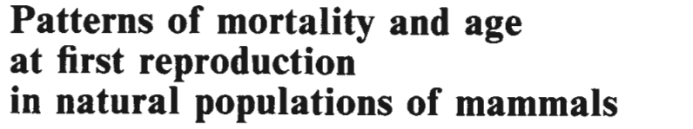
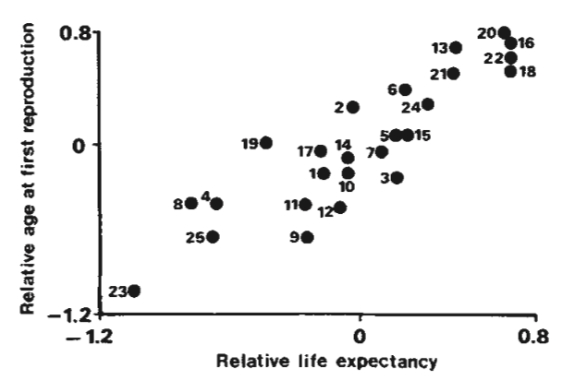
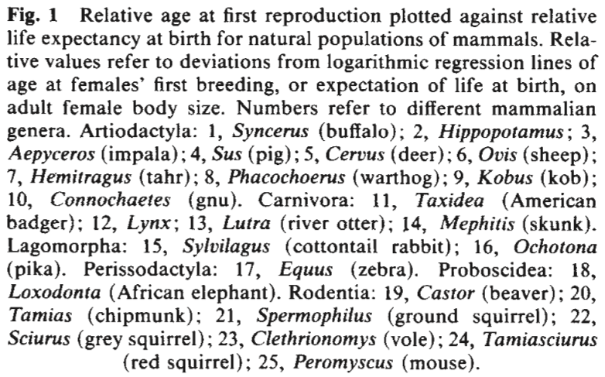
Harvey and Zammuto 1985

Slide 8
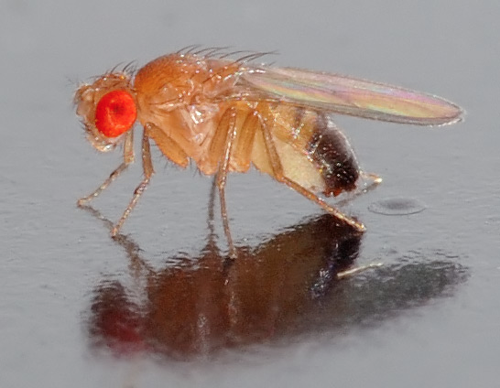
Evolution of age at first reproduction in Drosophilia
Photo credit: André Karwath

Slide 9
Evolution of age at first reproduction in Drosophilia
Later age at first reproduction (e.g. higher α) => higher fecundity (e.g. higher m_{x})
Later age at first reproduction (e.g. higher α) => higher juvenile mortality (e.g. lower l_{x})
This tradeoff emergences because both dependent on body size at maturity

Slide 10
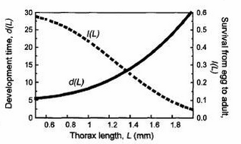
Body size at maturity, L

Slide 11
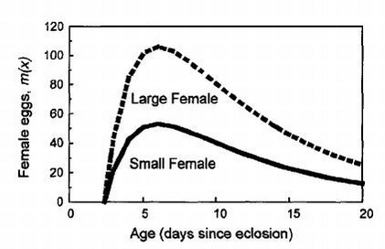
Fecundity

Slide 12
Juvenile mortality

Slide 13
Exercise 4
Complete the table using the graphs on the previous slides
Assume after reaching maturity, the probability of surviving another 5 days is 0.5
Calculate R₀ for the large and small genotypes
What type of life history tradeoff is represented by these life histories?
Notes:
Small:
l = [0.55 0.5x0.55 0.5^2x0.55 0.5^3x0.55]
M = [50 40 30 20]
Alpha = 5
R0 = .55x50+0.5x0.55x40 + 0.5^2x0.55x30 + 0.5^3x0.55x20 = 44
Large
L = [? 0.35 0.35x0.5 0.35x0.5^2]
M = [100 80 50 40]
Alpha = 10
R0 = .35x80 + 0.35x0.5x50 + 0.35x0.5^2x40 = 40.25

Slide 14
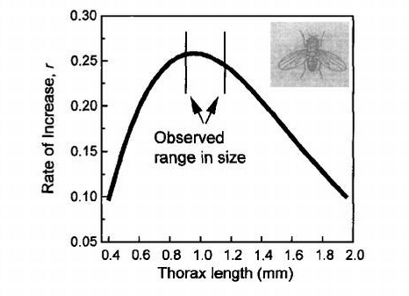

Slide 15




